Slide 1

Highly Accurate Protein Structure Prediction with AlphaFold Developed by Google DeepMind and EMBL-EBI
歐任翔 Mark Ou, PhD
Sep 25, 2024
Slide available here.
Notes:
European Molecular Biology Laboratory (EMBL)

Slide 2
Something About DeepMind
Central mission: solve fundamental problems with AI
=> Predicting the 3D structure of a protein form its amino acid sequence is one such challenge
https://www.nature.com/articles/s41586-021-03819-2

Slide 3
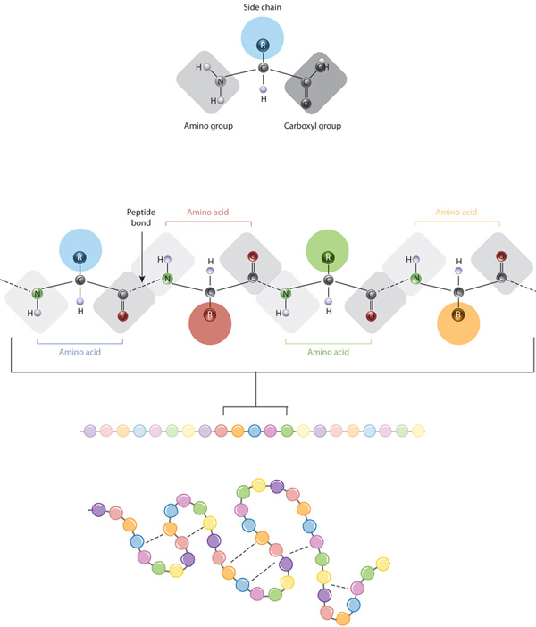
What are proteins?
Molecular machines which are essential to life
Have many functions, from hair to the immune system
Consist of chains of amino acids that fold into a 3D structure => The 3D shape is important for a protein’s function
Protein structures
Primary structure: Linear sequence of amino acids.
Secondary structure: Patterns like alpha helices and beta sheets formed by hydrogen bonds.
Tertiary structure: The 3D shape of the protein formed by side-chain interactions.
Quaternary structure: Complexes of multiple polypeptide chains or subunits.

Slide 4
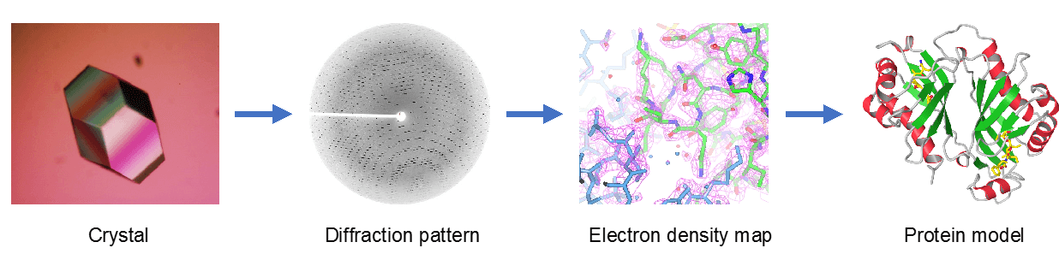
Why and how to predict protein structure?
Experimental structure determination takes months to years
Structure prediction can provide actionable information faster
X-ray Crystallography:
Other methods: NMR spectroscopy, Cryo-EM, EM
Notes:
Why did we want to predict protein structure?
X-ray Crystallography:
Protein-coding DNA
Express in cells
Break open the cells
Purify protein
Grow protein crystal
X-ray diffraction
Interpret the data
Protein structure

Slide 5
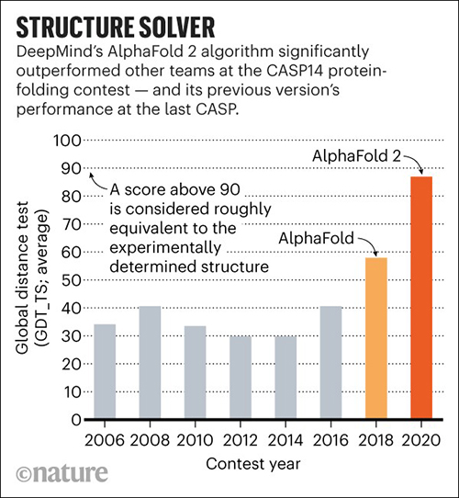
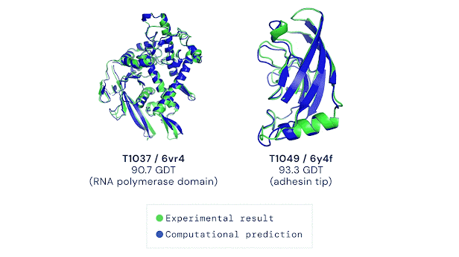
How well is the prediction by AlphaFold
Protein structure prediction community established CASP (Critical Assessment of Protein Structure Prediction)
CASP assessment involves the prediction of recently solved structures that are not public
From CASP 14 (2020), AlphaFold is the top-ranked method achieving consistently high accuracy
Notes:
AlphaFold 2 achieved a median accuracy of 92.4 GDT over all targets in CASP14.

Slide 6
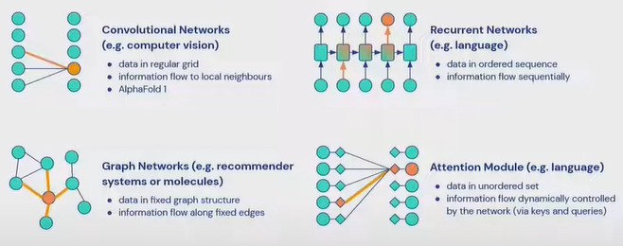
How AlphaFold works: INDUCTIVE BIAS FOR DEEP LEARNING MODELS
Examples:
卷積神經網路 | Convolutional Networks (CNN)
循環神經網路 | Recurrent Networks (RNN)
Used to process structured data with locality (such as sequence data)
Extract features from local regions in the protein sequence (interaction between amino acids)
Local sequence segments creates secondary structures
Used to process sequence data, particular for capturing long-range dependencies.
Capture interactions between distant amino acid → overall stability and folding
The 3D structures of a protein is not only determined by adjacent amino acid but also by long-range interactions (hydrogen bonds or hydrophobic interactions).
圖神經網路 | Graph Networks (GNN)
注意力機制 | Attention Modules
Used to process graph-structure data.
Considering amino acids as nodes and edges as their interactions, GNNs help learn the complex relationships between amino acids and convert this into structural information
Consider global information about the protein structure, not just local fragments.
It allow the model to focus on different part of a sequence based on the importance of each amino acid.
Certain amino acids are more crucial than others, especially in forming structural cores or functional regions.
Enable model to flexibly focus more attention on these important amino acids.
Notes:
Inductive bias (歸納偏差)
在深度學習中，歸納偏差（inductive bias）是指模型內建的假設，這些假設基於先驗知識或特定問題的資訊來引導模型的學習過程。在 AlphaFold（DeepMind 開發的預測蛋白質結構的深度學習模型）的情境下，為了提升模型的表現，納入了幾種形式的歸納偏差：

Slide 7
Putting protein knowledge into the model
Physical and geometric insights are built into the network structure, not just a process around it.
Inductive biases reflect our knowledge of protein physics and geometry
De-emphasized sequential order of amino acids (any amino acid can talk to any amino acid in that protein)
Instead, residues that are close in space need to communicate
Iteratively learning a graph of which residuals are close while reasoning over this implicit graph as it is being built
Notes:
We wanted to do in this case, put our knowledge about physical and geometric insights into that model and not just as a process around it but really into the architecture, and so one of the things that we've done is de-emphasize the sequential order of the amino acids really to reflect that any residual amino acid can talk to any amino acid in that protein.

Slide 8
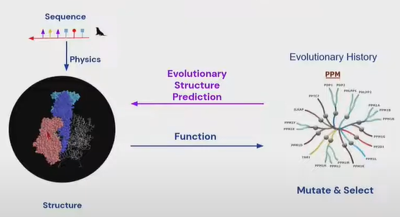
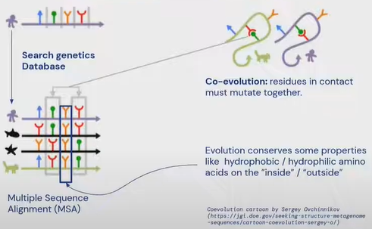
Determining structure from evolution
The structure needs to be similar to carry out the same function.
→ Given an evolutionally related sequence, we can try to computationally infer the structure.
Notes:
The structure needs to be similar to carry out the same function. Given an evolutionally related sequence, we can try to computationally infer the structure.
Fundamental of AlphaFold 2.

Slide 9
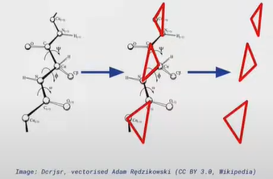
Considering other important factors
Structure module
End-to-end folding instead of gradient descent
Noisy student distillation (bootstrapping oneself for a better performance)
Make use of unlabeled sequences (didn’t have a known experimental structure)
Train AlphaFold on just PDB data → Predict structure on a large set of unlabeled sequences → Train second model where training set is enriched by confidently predicted structure of first model

Slide 10
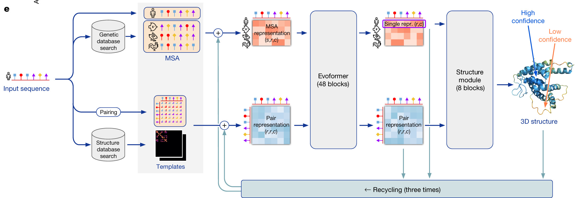
Overview

Slide 11
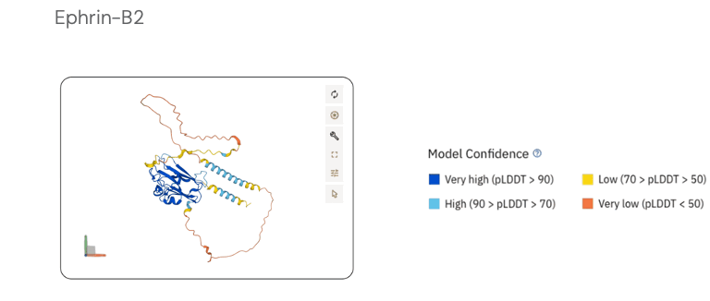
How to interpret predictions?
Predicted LDDT (local distance difference test)
A metric used to assess the accuracy of predicted protein structures by comparing them to the true (experimental) structures
Specifically, it measures how well the predicted atomic distance, both in backbone and side chains, matches the actual distance in the native structure
Ranging 0~100. The higher, the better.
Compared with the old criteria RMSD (root mean square deviation), which focuses on the overall alignment, LDDT emphasized the accuracy of local regions within the protein structure.
pLDDT < 50: don’t trust the structure or not taking any structure
pLDDT > 70: May work with the backbone predictions but may not want to trust the side chains in the area
pLDDT > 90: Reasonable to investigate side chains / active site details

Slide 12
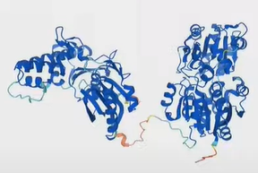
Pitfalls of pLDDT
High pLDDT on all domains does NOT imply AlphaFold is confident of their relative positions
Assessing inter-domain confidence requires a different metric

Slide 13
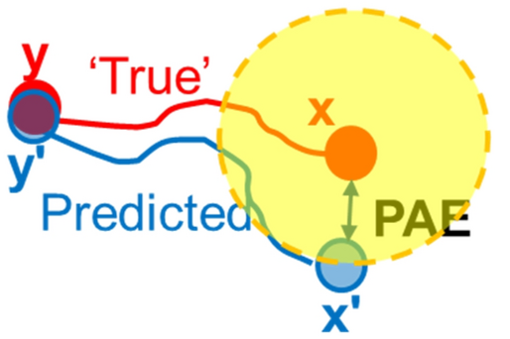
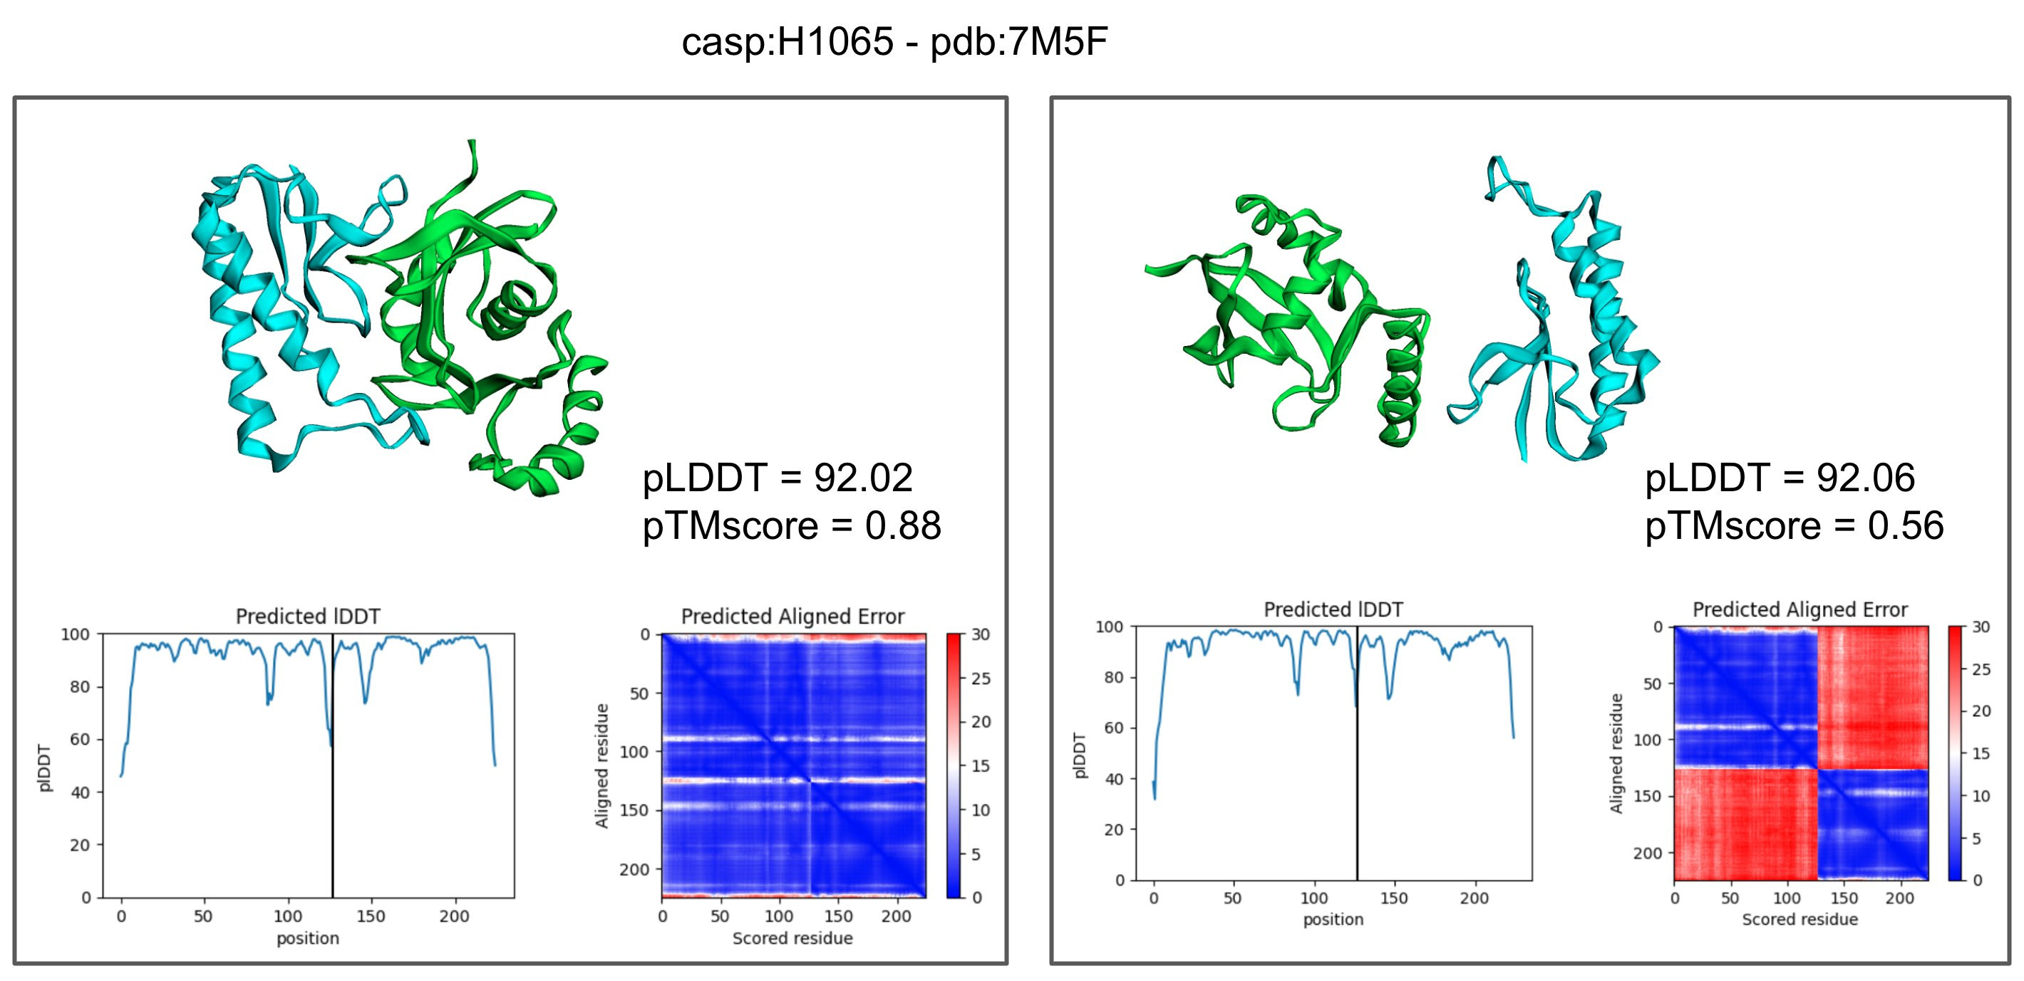
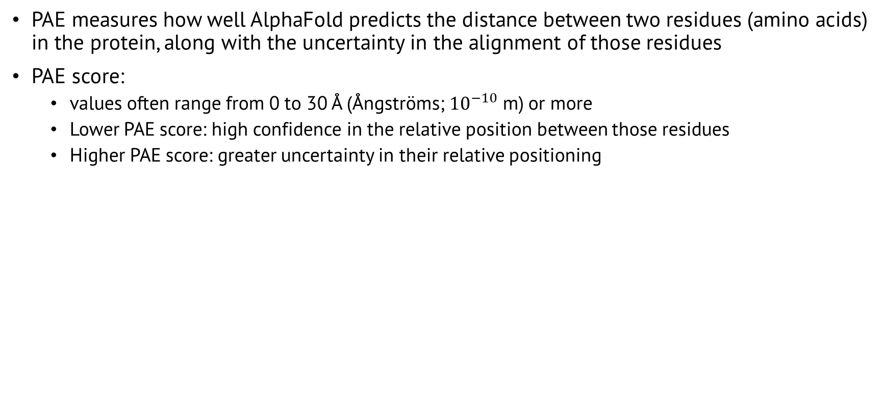
Predicted aligned error (PAE)
PAE measures how well AlphaFold predicts the distance between two residues (amino acids) in the protein, along with the uncertainty in the alignment of those residues
PAE score:
values often range from 0 to 30 Å (Ångströms; ${10}^{−10}$ m) or more
Lower PAE score: high confidence in the relative position between those residues
Higher PAE score: greater uncertainty in their relative positioning
Don’t trust how AlphaFold positions these two domains!

Slide 14
Limitations of AlphaFold
Only accepts the 20 standard amino acids in its input
(By default) predicts 5 models per run:
However, models are generally very similar
Usually cannot predict conformational variability in a protein
AlphaFold was not trained for
Predict assemblies (AlphaFold-Multimer was trying to do this)
Predict the effects of mutations (What AlphaMissense is trying to do)
Predict the binding of ligand molecules (some recent research is trying to achieve this using AlphaFold as the basic)
Predict nucleic acid structures

Slide 15
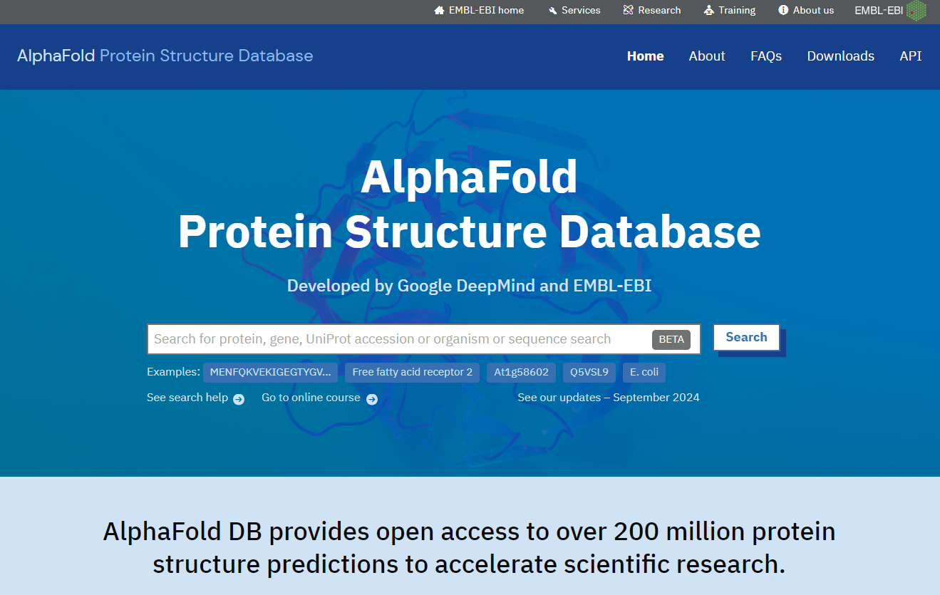
AlphaFold protein structure database
Website developed and hosted by EMBL-EBI
https://alphafold.ebi.ac.uk/

Slide 16
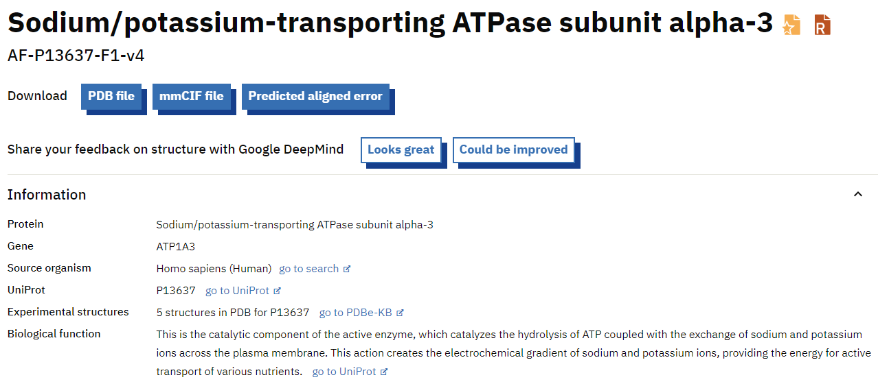
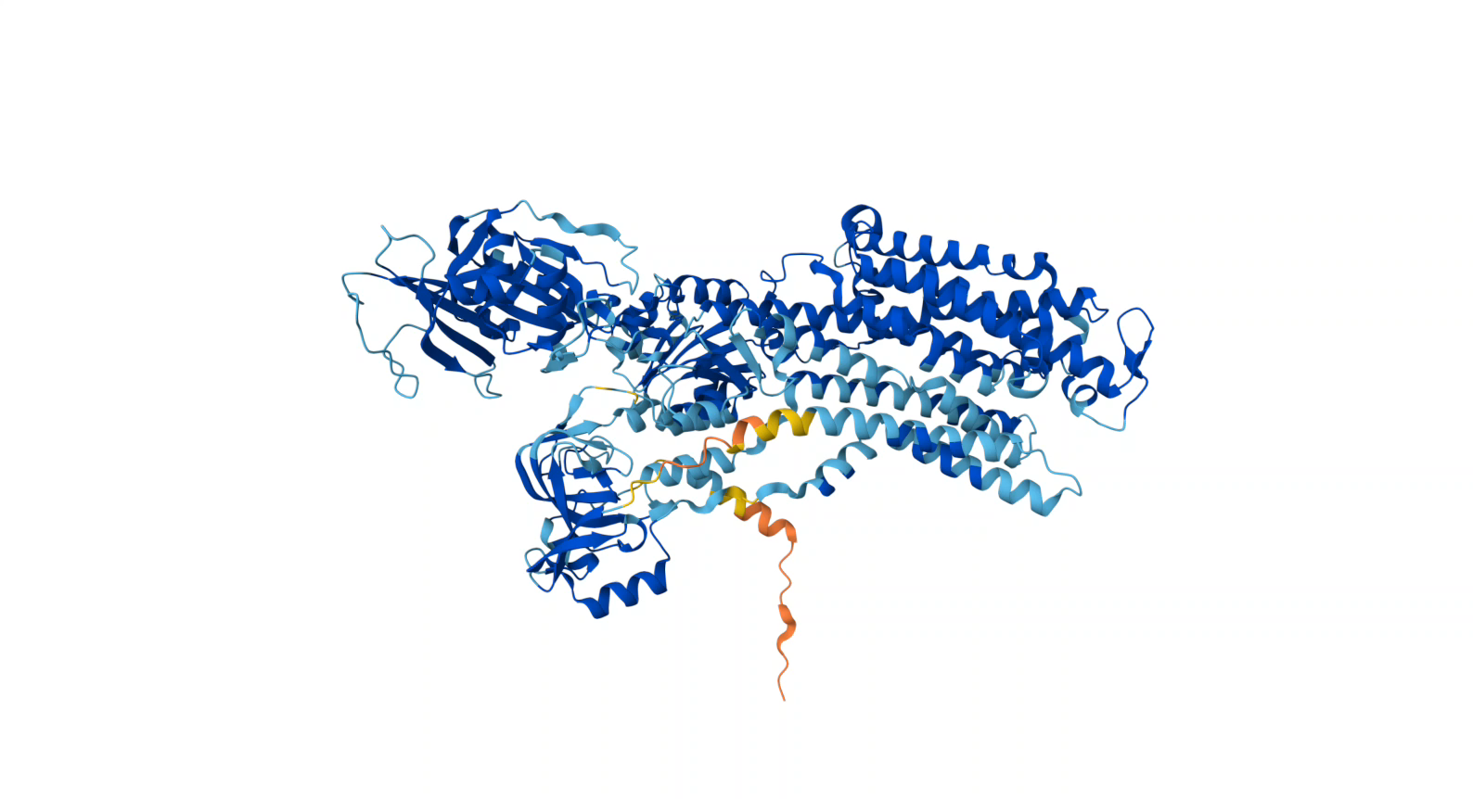
An example
PDB (protein data bank)
mmCIF (macromolecular crystallographic information file)
https://alphafold.ebi.ac.uk/entry/P13637

Slide 17
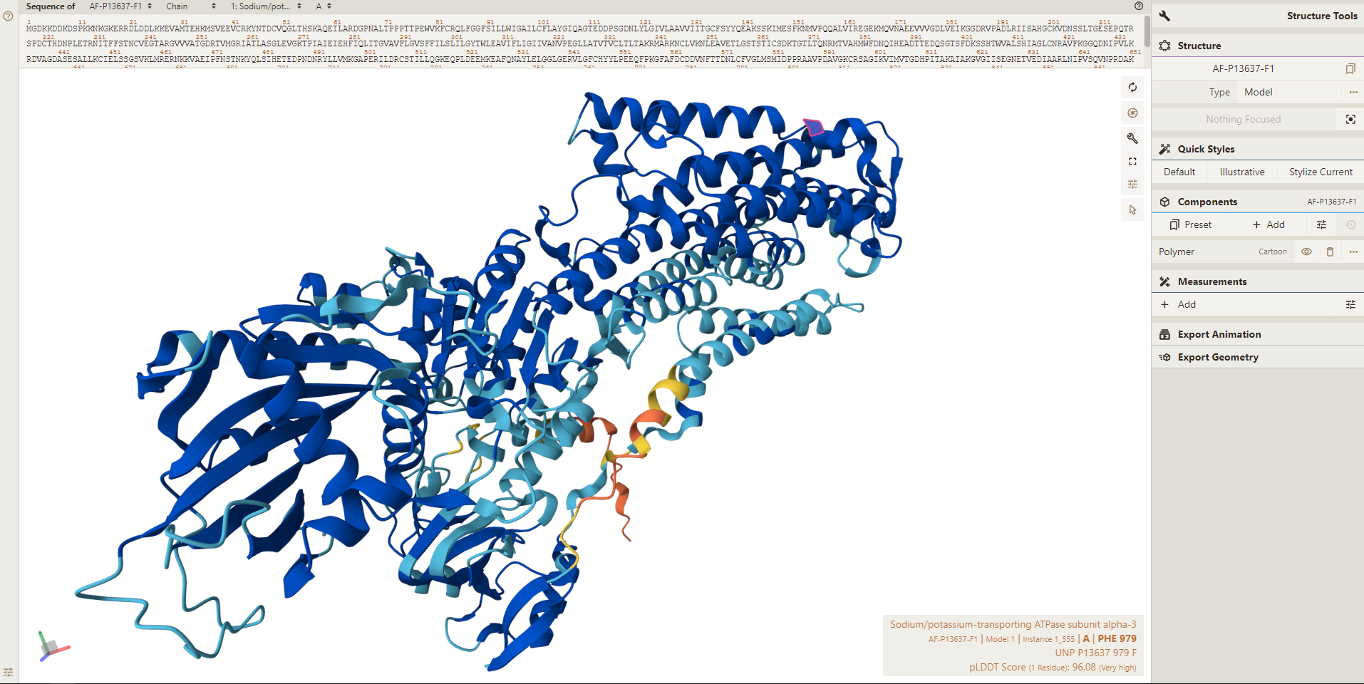
Structure viewer

Slide 18
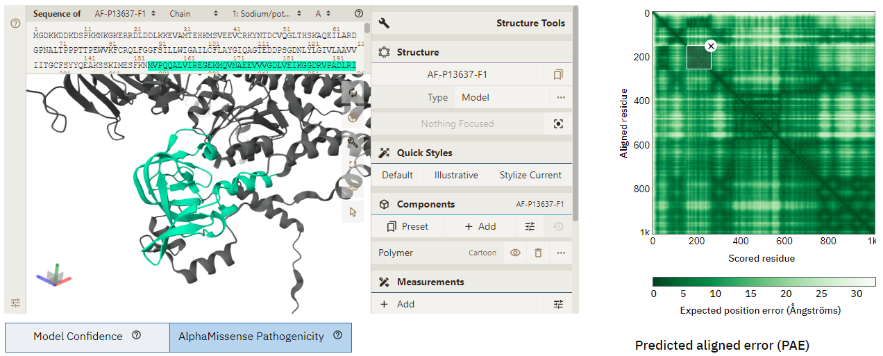
Predicted aligned error (PAE)
The heatmap on the website is interactive!
Assess relative domain positions.
Confident

Slide 19
Predict own data
Main ways of accessing predicted protein structures from AlphaFold:
The open-source code is publicly accessible at https://github.com/google-deepmind/alphafold
Total control over predictions
Need large storage space and a modern GPU
Interactive Google Colab notebooks: https://bit.ly/alphafoldcolab
More limited in terms of configuration
Easier to use, harder to break

Slide 20
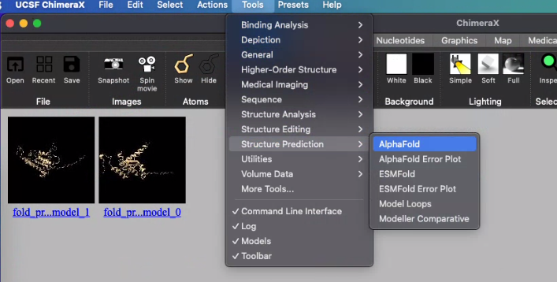
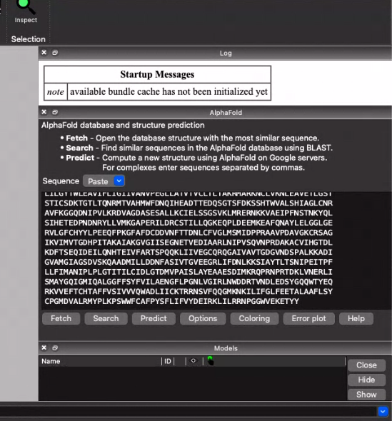
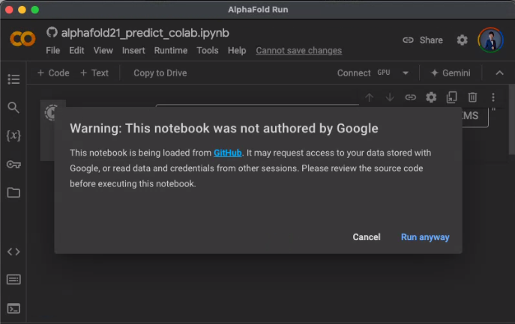
UCSF ChimeraX + Colab (google) + AlphaFold
paste sequence
Sequence data from UniProt: https://www.uniprot.org/uniprotkb/P13637/entry#sequences
Use commas to separate if more than one sequences

Slide 21
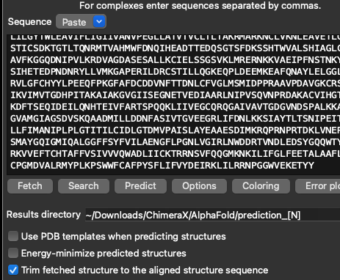
Options

Slide 22
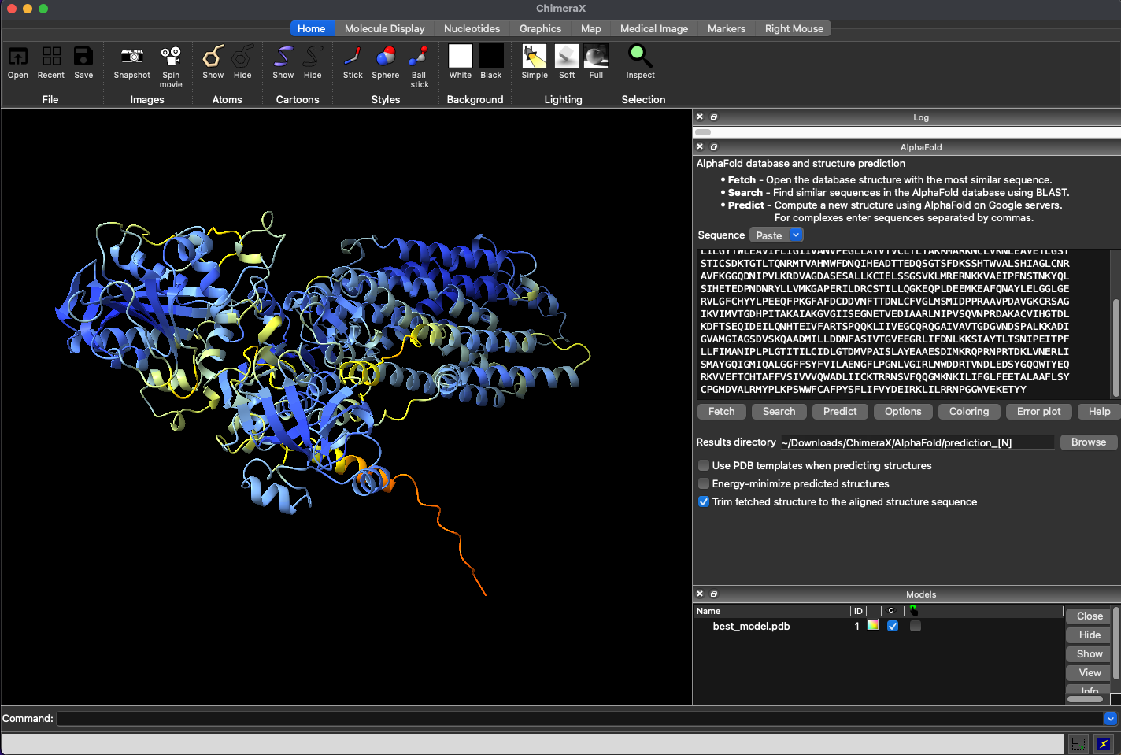
Result
Results available here: [prediction]

Slide 23
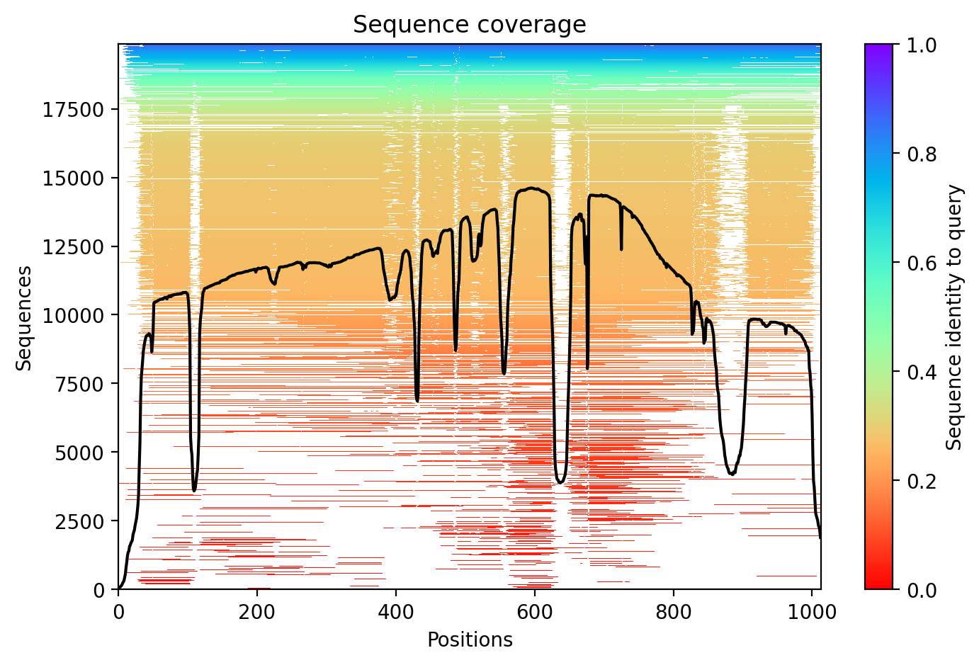
Sequence coverage
It refers to how well the target protein sequence is covered by other sequences in the multiple sequence alignment.
High coverage:
Many sequences in the MSA align to the target sequence at each position
Informed by a large amount of evolutionary data

Slide 24
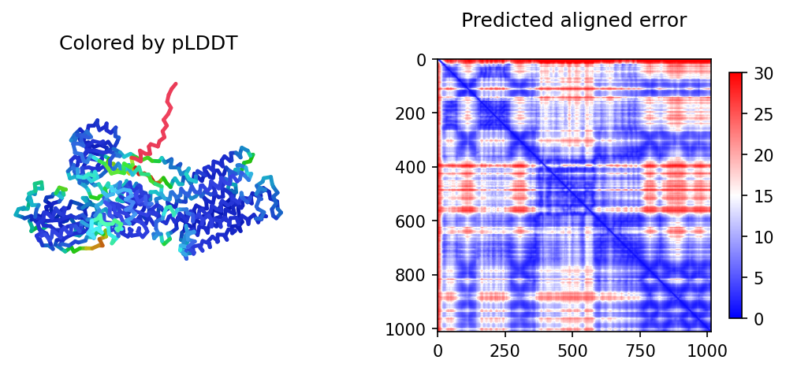
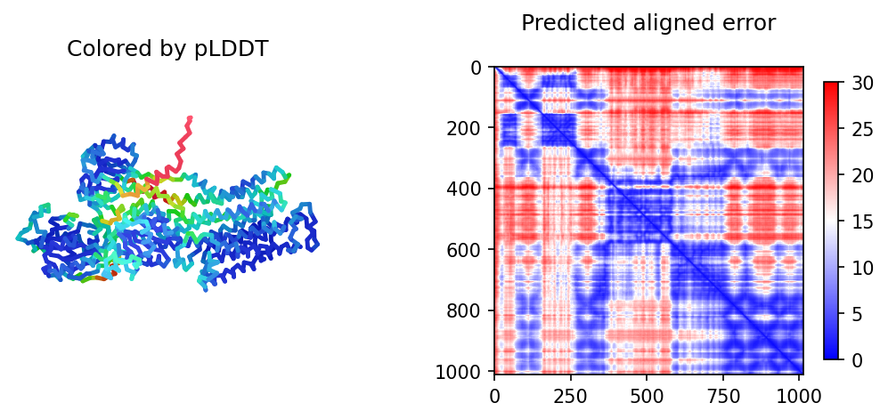
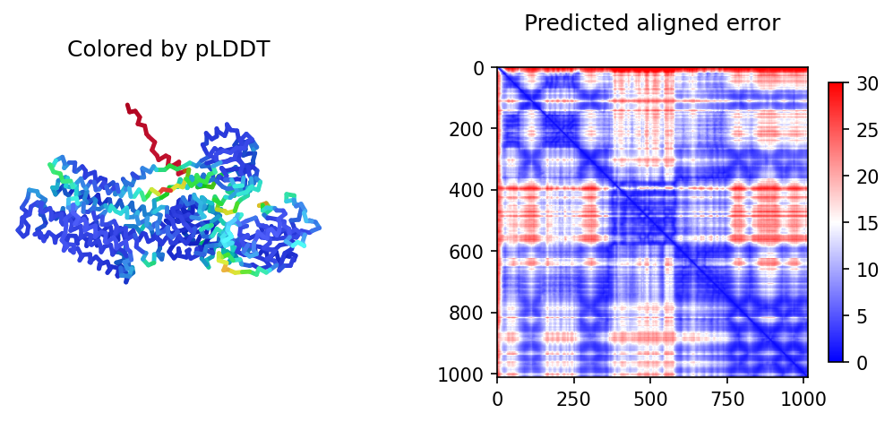
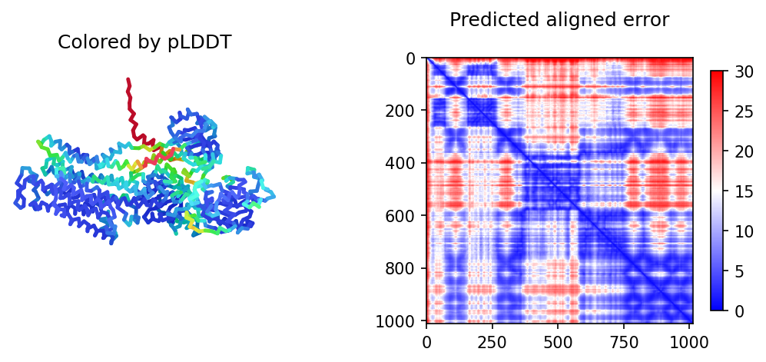
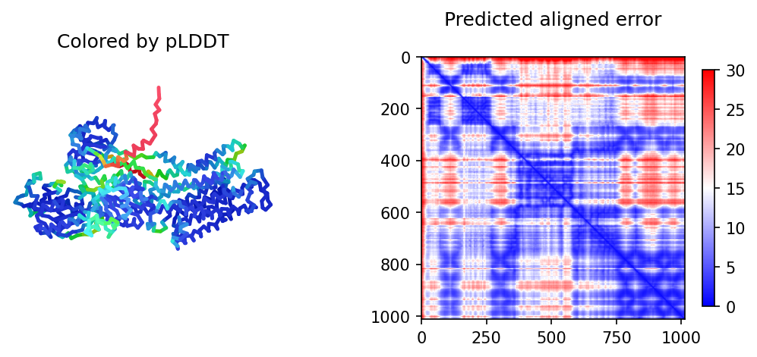
Different predictions

Slide 25
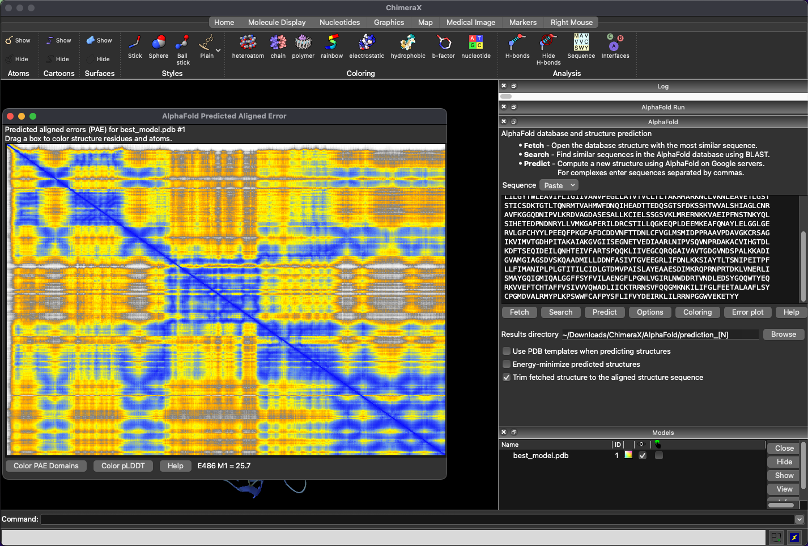
Show error plot in ChimeraX
https://www.cgl.ucsf.edu/chimerax/

Slide 26
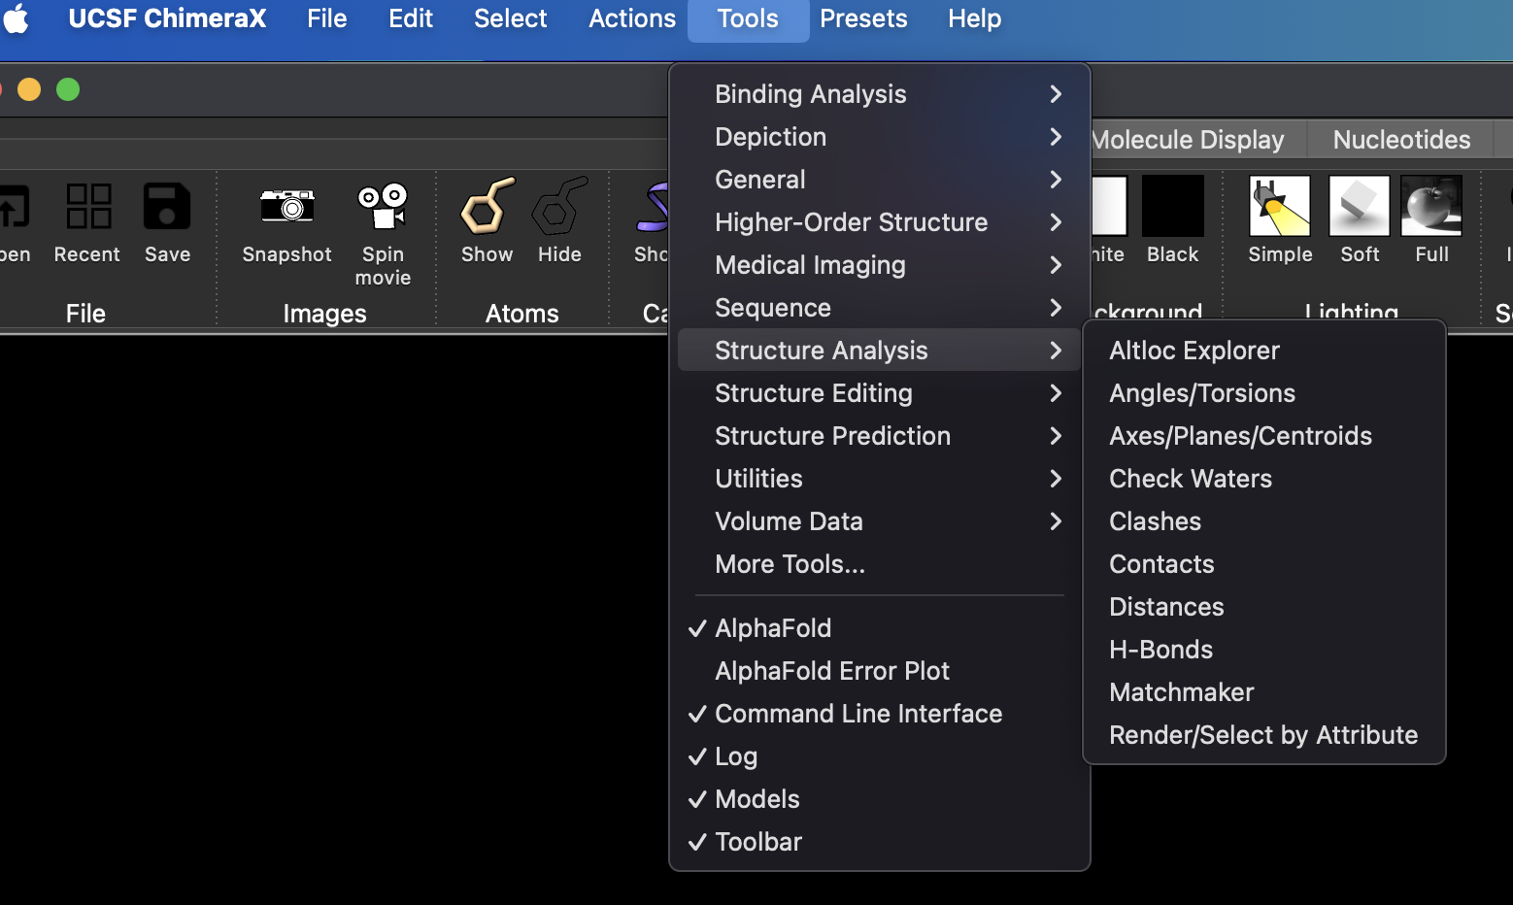
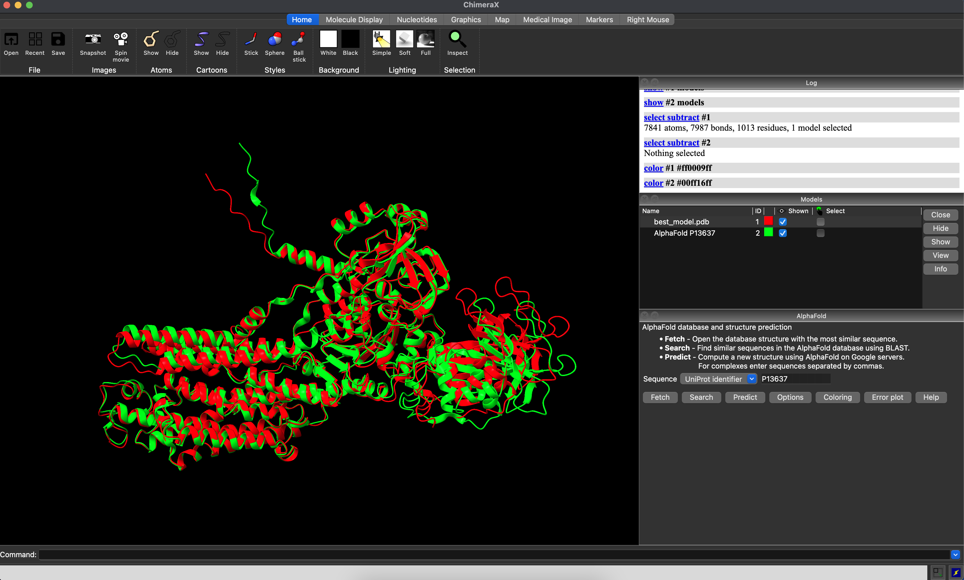
Align the predicted structure with the experimental result
Use different colors
Use matchmaker

Slide 27
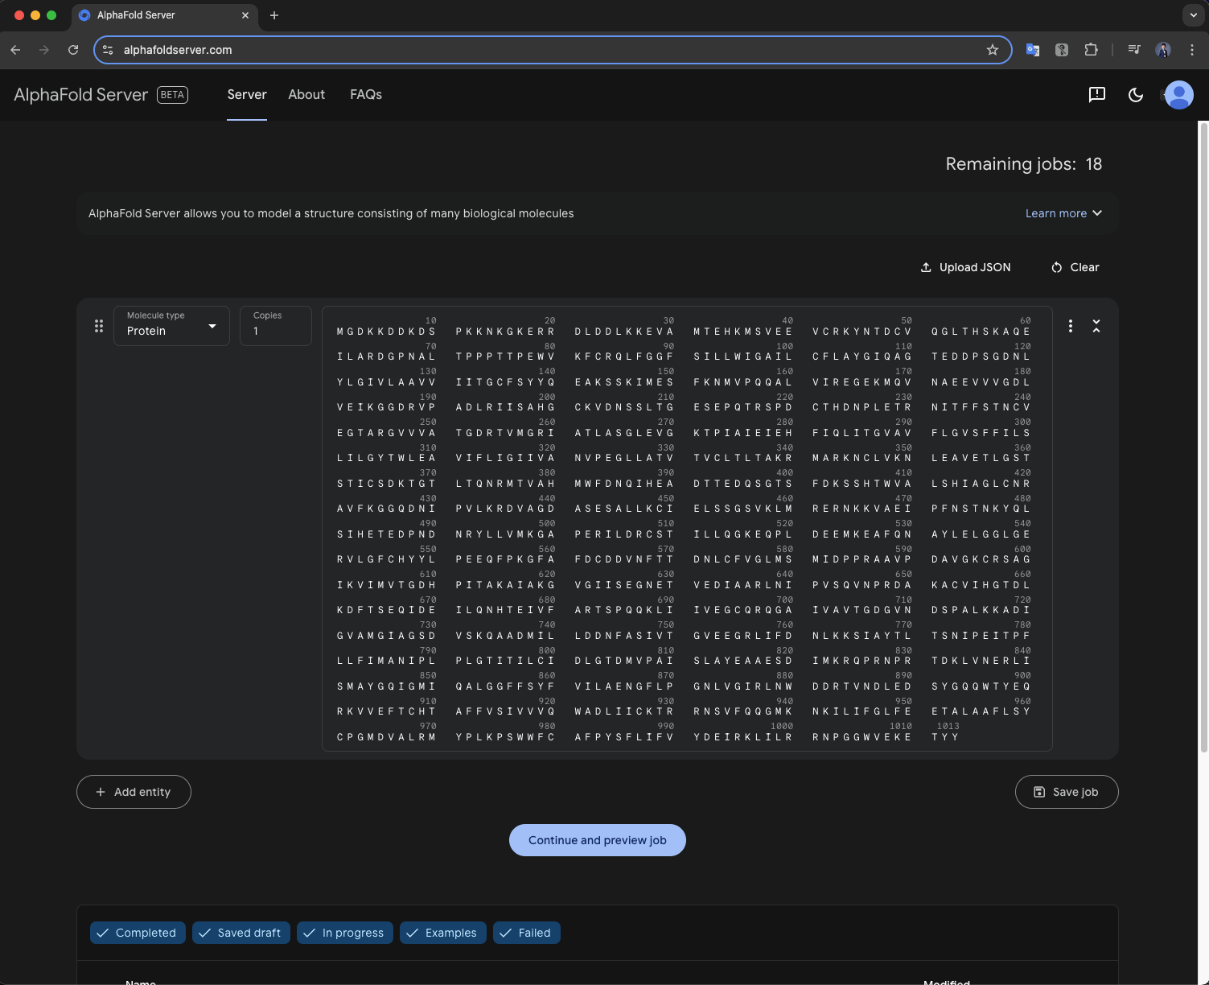
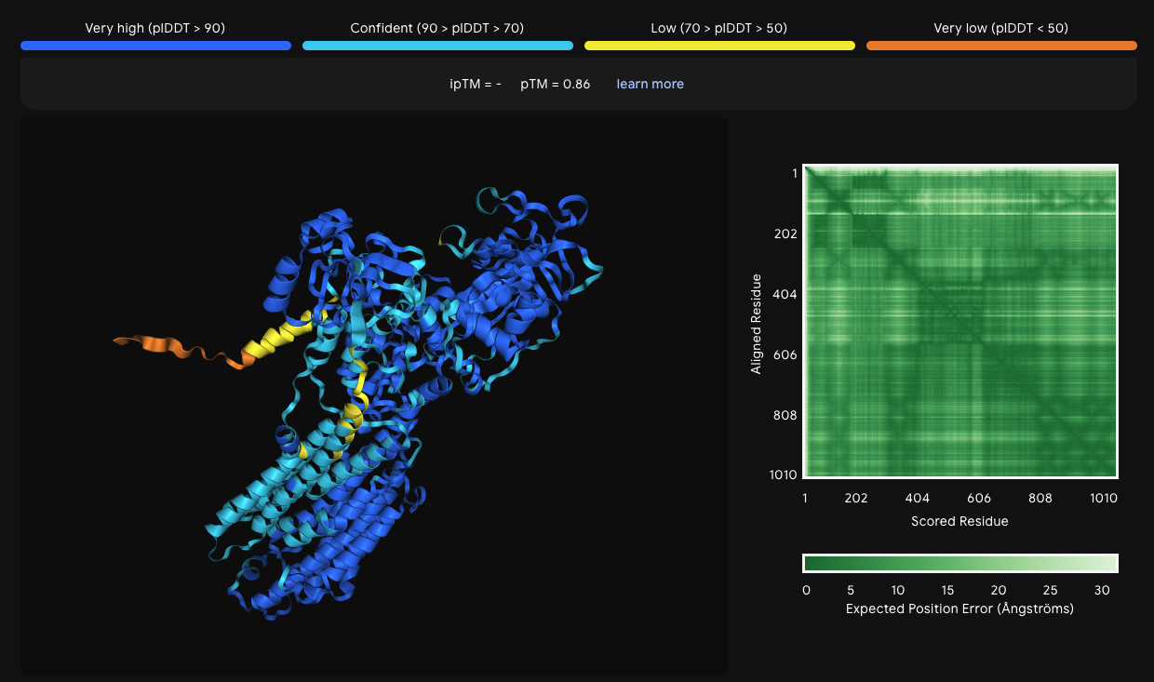
An alternative for Colab: AlphaFold server

Slide 28
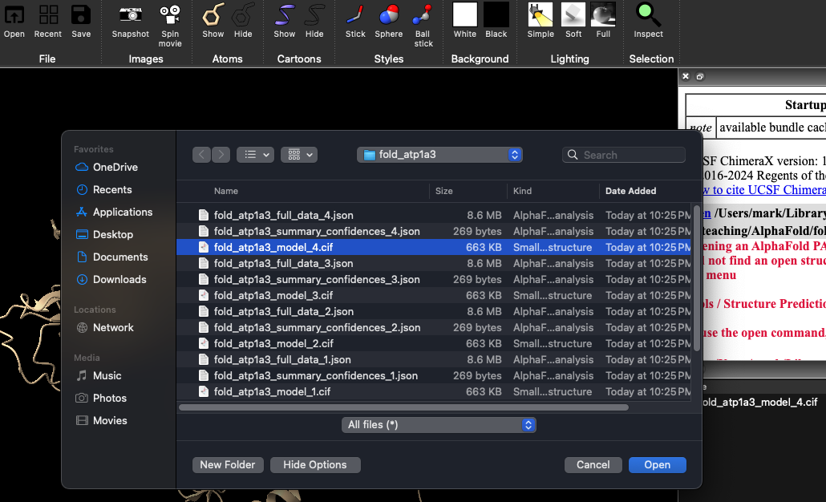
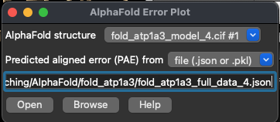
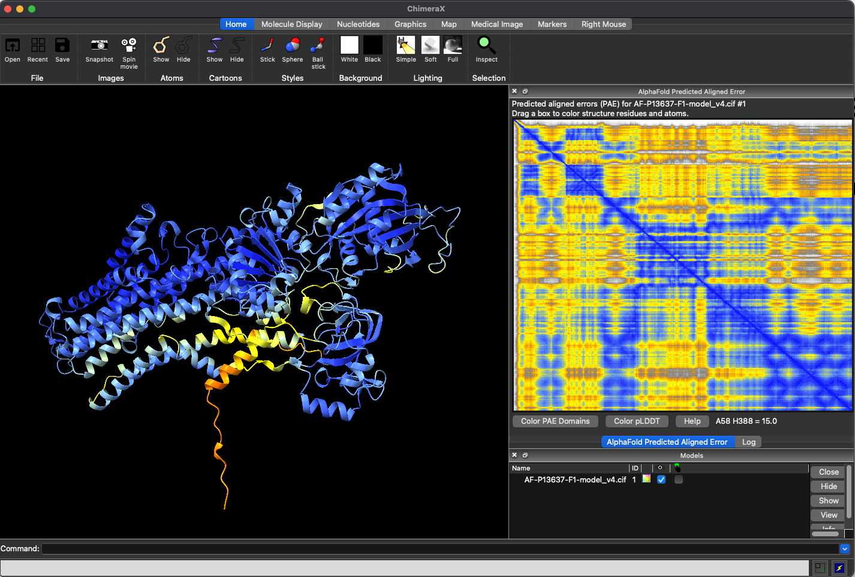
Open the results from the AlphaFold server in ChimeraX
Error plot info was safe as json format
Open protein structure
Results available [HERE]

Slide 29
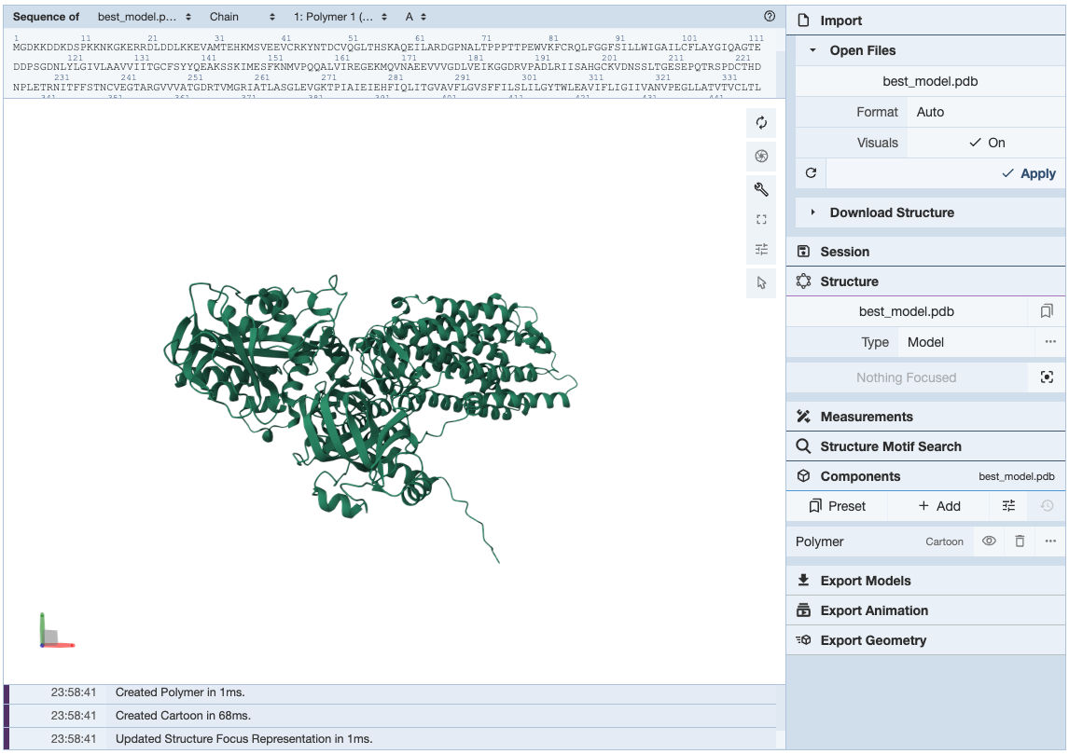
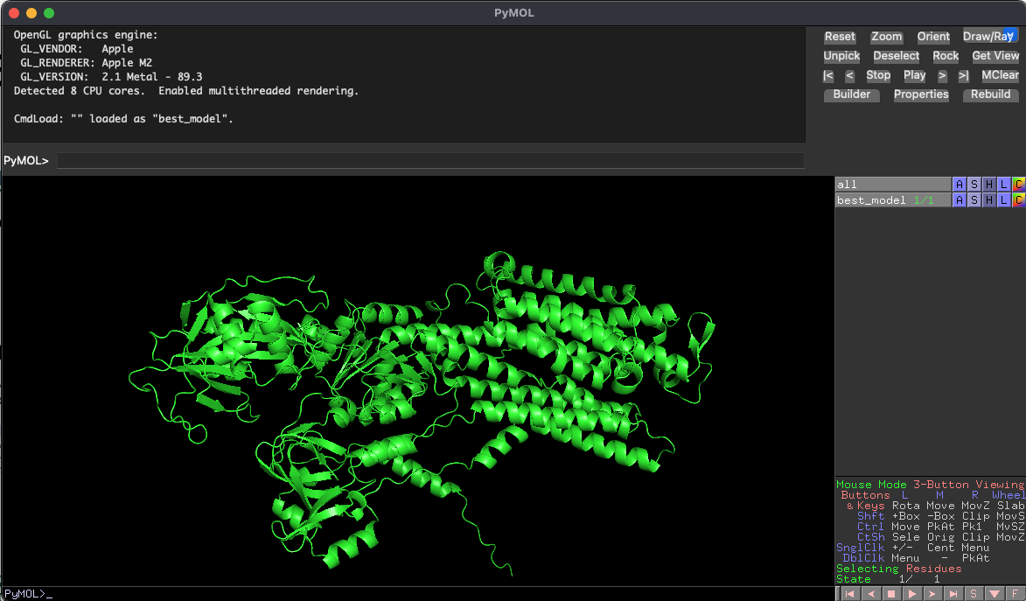
Other visualization tools
PyMOL: https://github.com/schrodinger/pymol-open-source
The open-source version has same functions as the commercial version
Installed in conda environment: conda install conda-forge::pymol-open-source
Mol* 3D Viewer
Hosted by RCSB protein data bank
https://www.rcsb.org/3d-view

